Slide 1
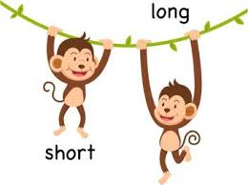
GRADE 1: MATHS
LONG AND SHORT
PRESENTED BY
B.JEHANYA
PRIMARY CLT COORDINATOR

Slide 2
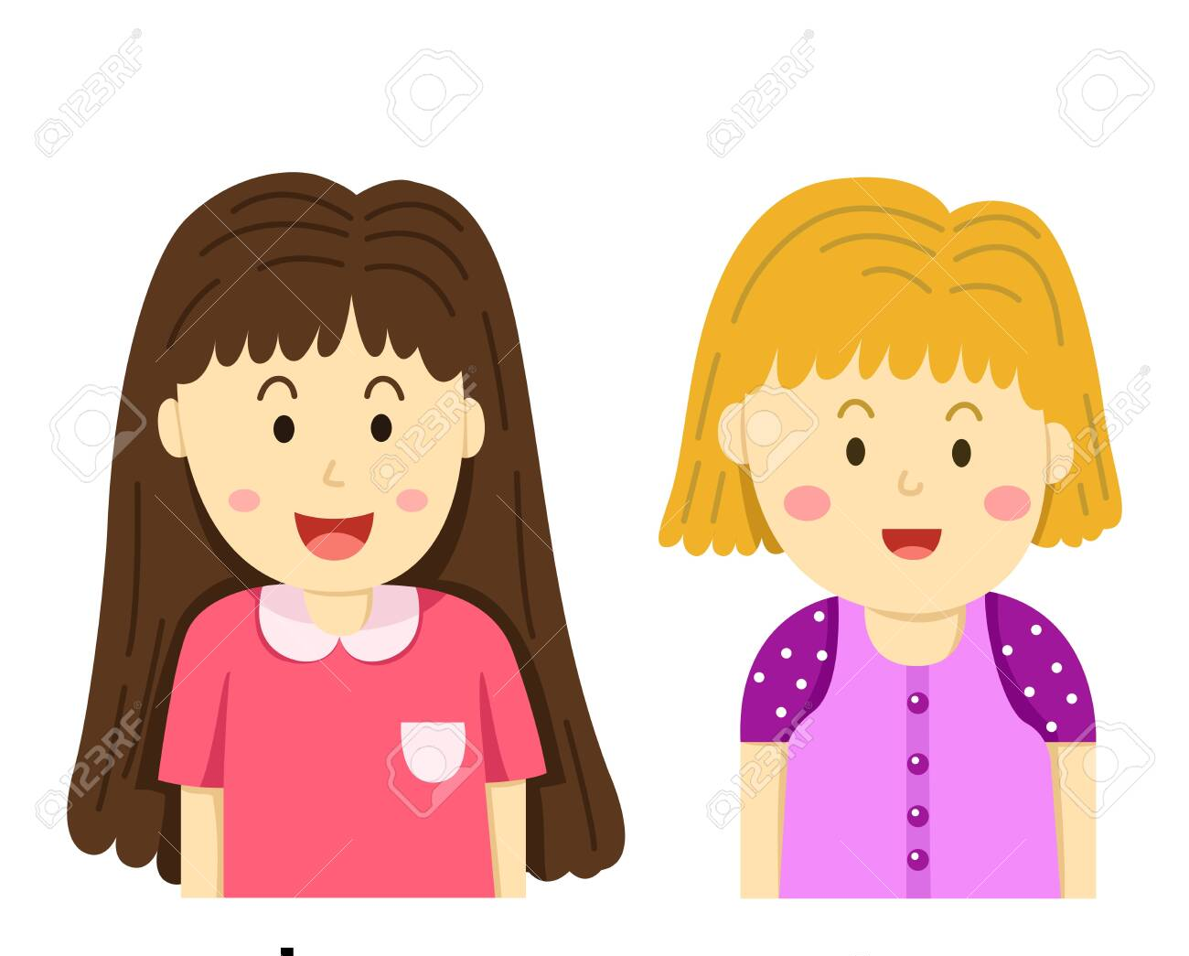
Who has the longer hair?

Slide 3
Which animal has a long tail?

